Slide 1
Group Poorna Suraksha Customized Protection Plan For ICAI Members

Slide 6
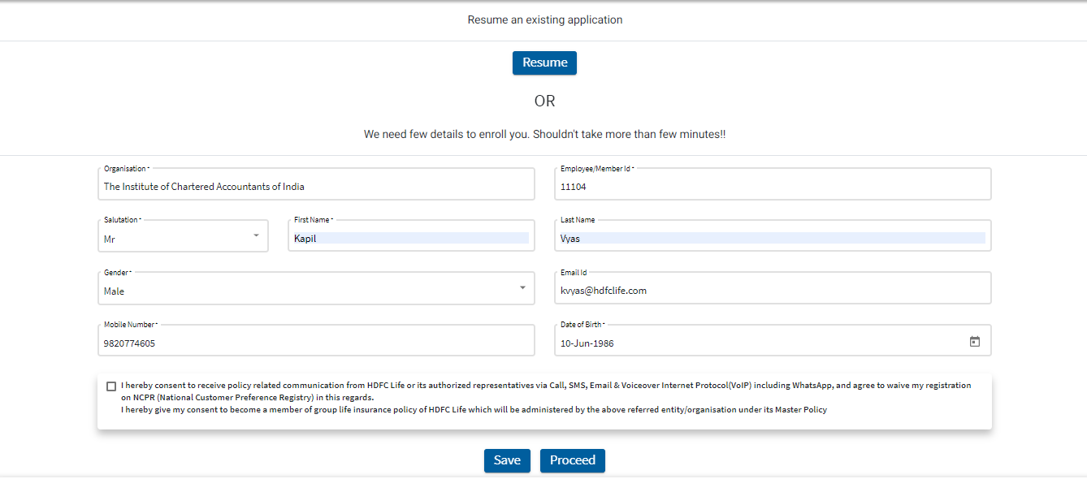
Intent Generation Page – Step 1
Select the Name of your organisation followed by your personal details and proceed

Slide 7
OTP Verification – Step 2
- Enter Mobile Number and proceed with OTP.
- Maximum 3 OTP’s per day are allowed

Slide 8
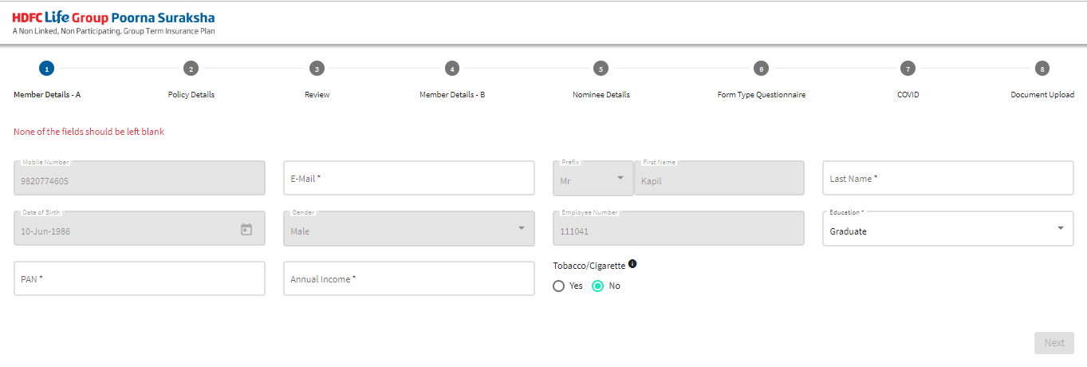
Proposal Form Submission – Step 3
Continue with proposal form filling, followed by payment and document upload

Slide 9
Resume Application
In case proposal form is closed midway, you can click on Resume tab at the top of screen on our link.

Slide 10
Contact Points
For any queries kindly reach out to
RM Name | Contact | Email | Level 1 Escalation | Contact | Email | Level 2 Escalation | Email
Sivasankar | 9962055518 | SIVASANKAR02@HDFCLIFE.COM | Kapil Vyas | 9820774605 | kvyas@hdfclife.com | Rakshak Malhotra Dhanashri Mane | rakshakvinodm@hdfclife.com dhanashrim@hdfclife.com
Rinku Shah | 9820448820 | rinku.s06@hdfclife.com
For more details kindly refer to FAQ document

